Slide 1
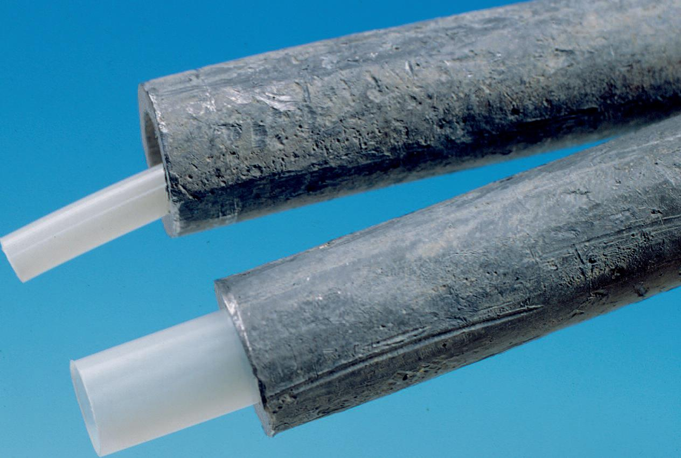
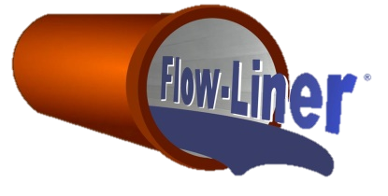
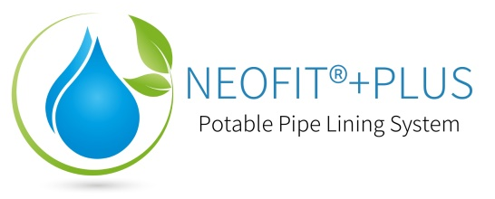
Neofit®+Plus Potable Water Service Lining System

Slide 2
NSF/ANSI 61 Certified
The Water Quality Association has issued certification for Neofit to the standards of NSF 61/ANSI 61 and NSF 61/ANSI 372.

Slide 3
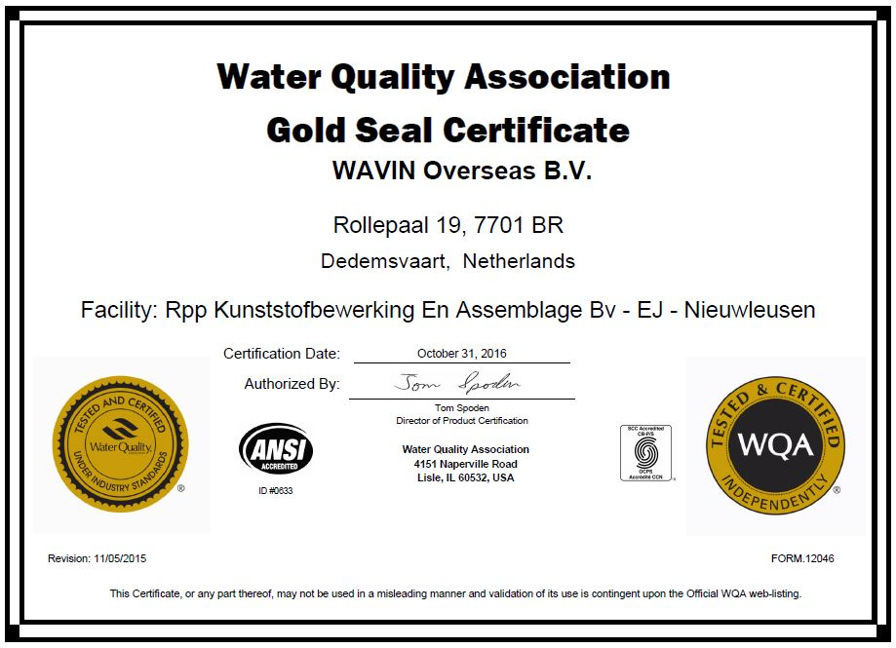
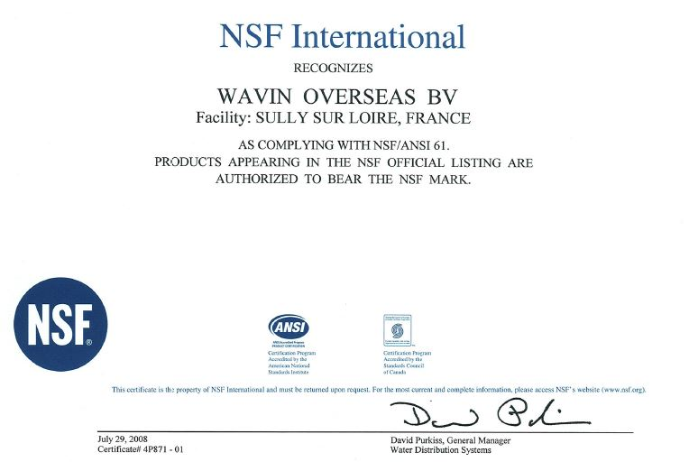
NSF/ANSI 61 Certified
The Water Quality Association has issued certification for Neofit to the standards of NSF 61/ANSI 61 and NSF 61/ANSI 372
NSF/ANSI 61 testing covers all products with drinking water contact from source to tap, and determines what contaminants may migrate or leach from your product into drinking water. It also confirms if they are below the maximum levels allowed to be considered safe.

Slide 4
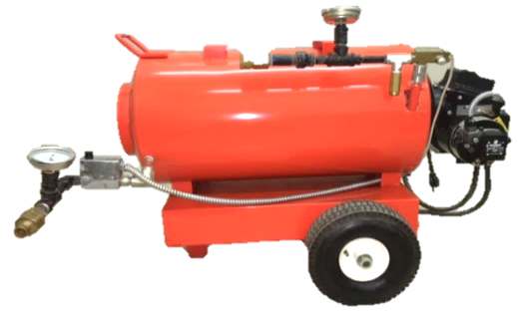
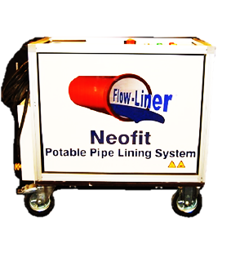
What is Neofit? – The Basics
Neofit (Virgin PET: Polyethylene Terephthalate) is a cost-effective, trenchless, non-invasive, semi-structural pipe lining system for existing water service lines. Neofit helps maintain the existing service pipe by re-lining, not by replacement. Its purpose is to create a safe barrier in existing lead or copper service piping, extend the existing service pipe’s life, or to seal leaks and pinholes. Because of the smooth PET of the liner, flow capacity is not negatively effected. Designed for ½” to 2” ID and up to 300ft sections.
U.S. Patent No. 8,807,171

Slide 5
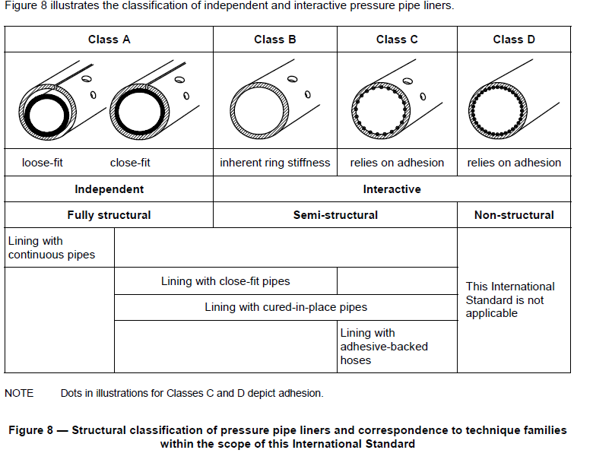
What is Neofit? – The Liner
Neofit is not a coating technology.
Neofit is not a replacement pipe.
Neofit liner is classified as an interactive semi-structural liner Class B, Close fit that does not need to rely on adhesion.

Slide 6
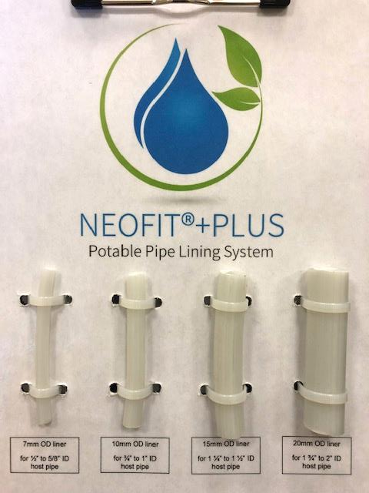
What is Neofit? – The Liner
Neofit liner comes in rolls of: 7mm – ½” 10mm – ¾” 15mm – 1” 20mm – 1-1/2”+

Slide 7
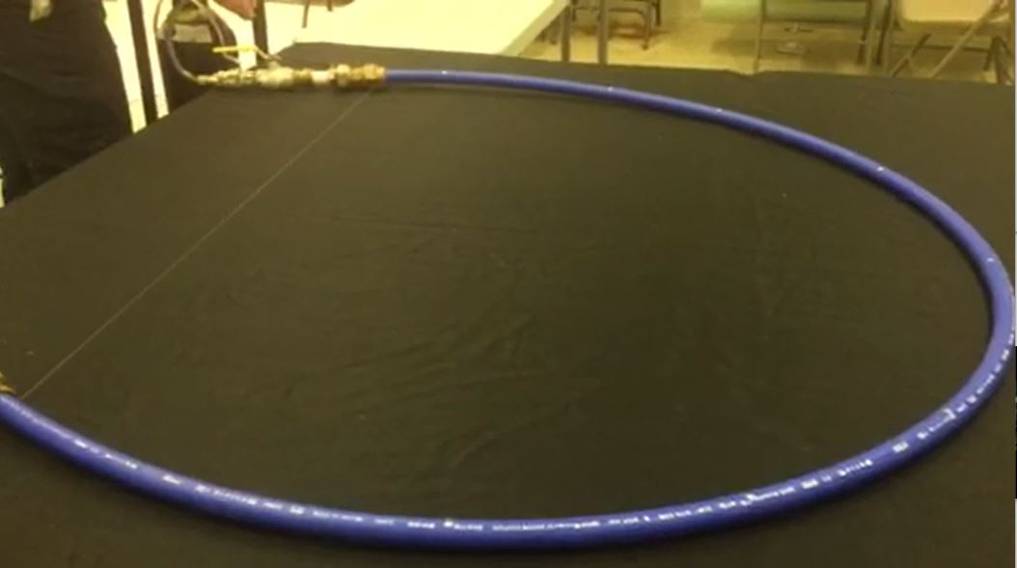
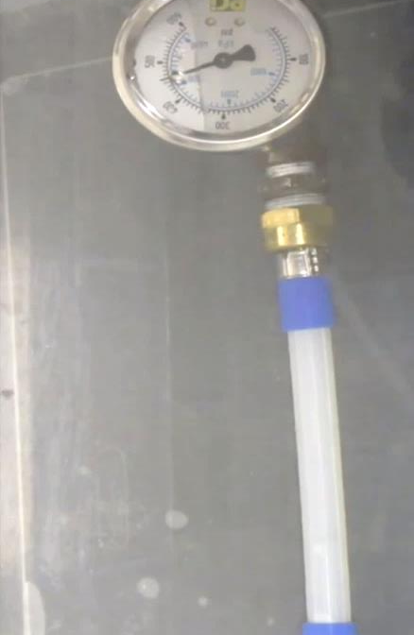
Neofit Extreme Testing
1) 150psi Leak Test Neofit Liner
2) 460psi Burst Test, Expanded Stand Alone Neofit Liner
Neofit® liner installed in PEX tubing with 3/8 inch holes in the PEX every 8-12 inches. The fittings used were compression style with the Neofit® liner having a flange at each end. This would represent an extreme leaking water service lining installation. The Neofit® lined pipe was pressurized to 150 psi and held for 48 hours with no leaks
Stand-alone Neofit® liner burst test as per ASTM D1599 for pressure testing of structural piping. The stand-alone Neofit® liner burst @ 460 psi

Slide 8
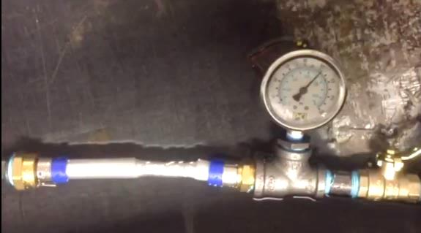
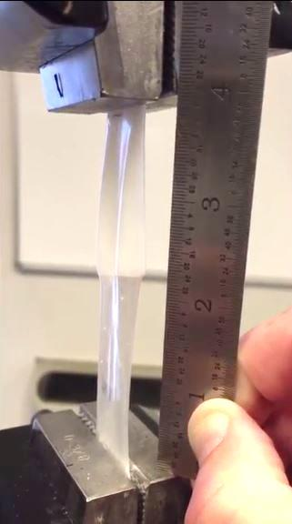
Neofit Extreme Testing
3) Expanded Stand Alone Neofit Liner Stretched Doubles Length
4) 105psi Burst Test, Expanded & Stretched Stand Alone Neofit Liner Under Pressure
Stretched and stressed 10mm Neofit Liner from previous tensile test was capable of holding up to 105 PSI before bursting, as per ASTM D1599.
Tensile test of 10mm Neofit Liner expanded to 3/4" pipe size. Results show a 2" section was stretched to 4" without any tearing or damage to the liner.
Full length testing videos can be found at https://flow-liner.com/neofittesting

Slide 9
What is Neofit?
PET
Chemistry - Virgin PET Only- The Neofit Liner is made of PET (polyethylene terephthalate), the same material as the common water bottle, but manufactured much stronger (X4) and tested to a minimum 50+ year life expectancy. Neofit Liner only uses virgin PET, as opposed to recycled PET, which is becoming more frequently used in other markets due to the resilience of virgin PET that causes further issues in for the environment, i.e. landfills.
Recycled PET has been used for soda and water bottles since the early 1980s with no reports of any short term or long term health issues to humans.
Long-term effectiveness of Neofit
Estimates compiled from the U.S. National Park Service, United States Composting Council and numerous other federal and state agencies, estimate plastic water bottles made of PET may last 500+ years in the landfills. This is an example of the long-term life expectancy of the material.
While we fully expect Neofit PET liners to endure well beyond their minimum life expectancy of 50 years, it is important to note that PE, as our most commonly used potable water pipe material, has the exact same design life under ISO calculation. Even PVC has similar life expectancies and they are not questioned. Large pipe companies, such as Charlotte pipe, have similar warranties with similar life expectancies, as well.
Medical Implants – PET has been used in medical devices since the 1960s due to it’s ability to remain sterile, flexibility, and ability to withstand the test of time. Zero evidence of harmful effects from virgin PET devices

Slide 10
What is Neofit?
PET
Chemical concerns
NSF 61 testing covers all products with drinking water contact from source to tap, and determines what contaminants may migrate or leach from your product into drinking water. It also confirms if they are below the maximum levels allowed to be considered safe.
VOCs – Volatile Organic Compounds are no issue for virgin PET, and the NSF certifications proves it. VOC contamination is top of the list for NSF testing, along with BPA.
Chlorine - Residual Free Chlorine & Free Chlorine Demand – Decreased with each exposure, according the Water Research Foundation
Unlike coating technologies, there is minimal chlorine demand- Better than replacement! “The chlorine demand exerted by the PET liners in this study was much lower than that observed in the control pipe sections” (WRF)
Plastic Leachates – The concern with leachate is widely credited to recycled PET. Virgin PET has minimal risks of leachates. Specific leachates addressed were phthalate esters and phthalic acids; none were detected in any of the three fill-dump extractions done in the WRF report. In investigating further under extreme conditions, “pieces of the liner were extracted with a 50:50 mixture of hexane and chloroform, with acetonitrile, and with a 10:90 mixture of methanol and water (10:90). These extractions also yielded no detection of phthalate esters or phthalic acids. The lack of leaching is likely attributable to the purity of the PET used in the liners.”(WRF)

Slide 11
Neofit Progression
First used in Europe in the early 1990s
Introduced to US in 2008 with its first pilot for Louisville Water in Kentucky
By 2017, US engineers recognizing the validity of Neofit for LSLs
2019
Flow-Liner and Sanexen will be working toward inclusion of “rehabilitation” in the upcoming EPA LCR rewrite and securing approvals for Neofit to be included as a replacement option or part of replacement programs for water authorities throughout the US and Canada
USA Learning Curve
Obtaining state approvals and ASTM Standard in 2018+
LCR
Lining is not specifically addressed in the current LCR; however, as we all know, it is undergoing revisions, and alternatives to replacement are becoming a hot topic. It is important to note that there is no prohibition against lining, and to understand the “test out” exemption. If lined pipe’s water samples pass the requirements, they can avoid the mandatory replacement. (EPA)

Slide 12
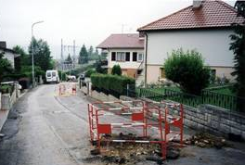
Neofit Case Studies
France: over 200,000 services
In total, exceeding 2000 miles of Neofit lined service pipes
Netherlands, Belgium:
Utilizing Neofit since 1995
Other countries from 2004 on:
Germany, Austria, Australia, Japan Norway, Malaysia, South Africa, Ireland, UK

Slide 13
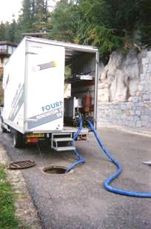
Neofit Case Studies
France
City | # of Services | Installer
Monbéliard | 450 | Generale des Eaux
Dole | 200 | SNCTP
Orléans/Chateaudun | 300 | SAUR
LaTour du Pin | 300 | Fournier TP
Vichy | 200 | CBSE
Cahors | 300 | Capraro & Dubreuilh
Chalons-in-Champagne | 100 | Nord Est TP
Lons-le-Saunier | 100 | Service des Eaux
Pontarlier | 200 | Sté Toubin
Alferink, F. (2009) Neofit Case Histories.

Slide 14
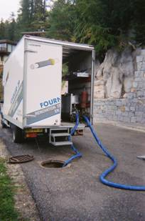
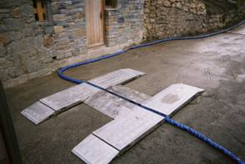
France
Alferink, F. (2009) Neofit Case Histories.

Slide 15
Neofit Case Study- Wessex Water Services
Wessex Water Services
Installation: Salisbury, United Kingdom, 1991
Pre Installation Lead Levels
75-110ppb
Post Installation Lead Levels
Weekly to Month Sampling until 1993
Oct 1991- June 1993
100%<7ppb, 94% <5ppb
The Issue of outliers – testing can be affected by lead water in the main, and lead fittings and fixtures.
Wessex Water expressed in writing that the performance of the liner had been very satisfactory since it was installed. (Elzink, 2018, Case Histories)
Note: Bacteriological colony counts recorded as low with no differences in comparisons to other homes on same supply source.

Slide 16
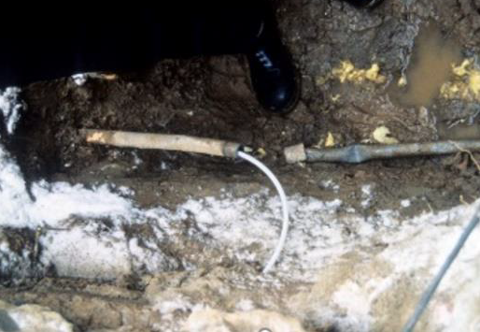
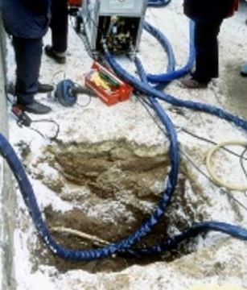
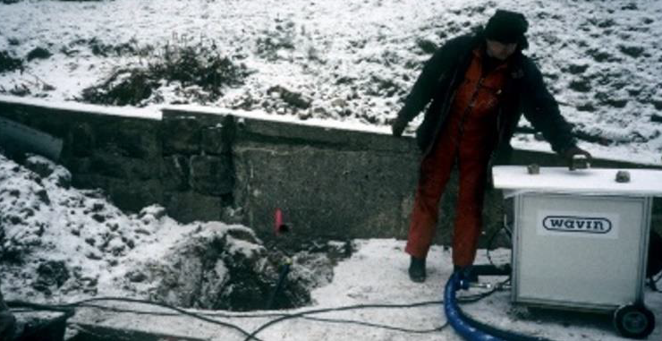
Neofit Case Study - WVW
Local water supply Trinkwasserzweckverband Weißeritzgruppe (WVW) in Freital, Germany, installed Neofit in 1995.
As per date of this report (Elzink, 2018, Case Histories), and 23 years later the with Neofit lined ¾” lead service pipe is still in operation, with very satisfactory performance, supplying 140-160 m3/yr.
The water quality is monitored by WVW on a regular basis and made available to the end users. Lead content is one of the parameters registered and was < 1.0 ppb.

Slide 17
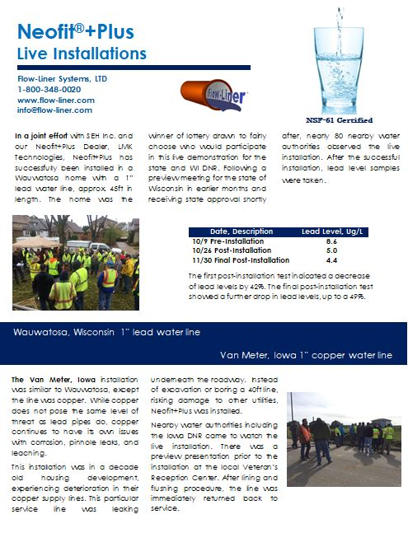
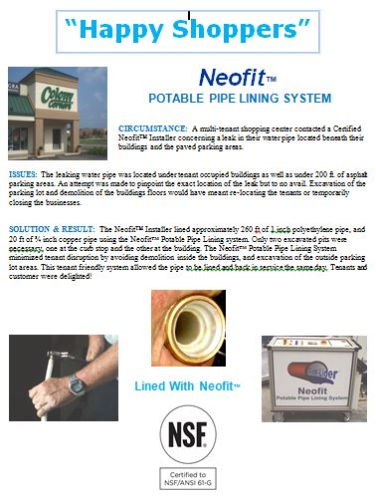
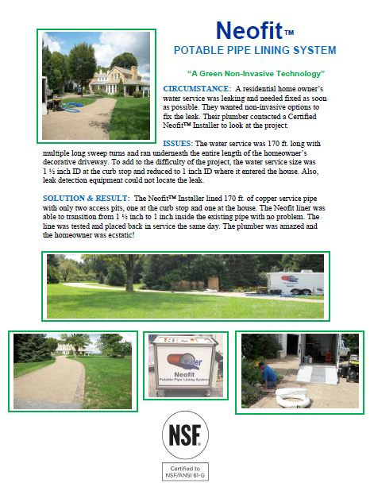
Neofit Case Studies – North America
Several Installations since 2008, some listed below:
Louisville Pilot
Iowa/Wisconsin
Commercial and Residential Examples

Slide 18
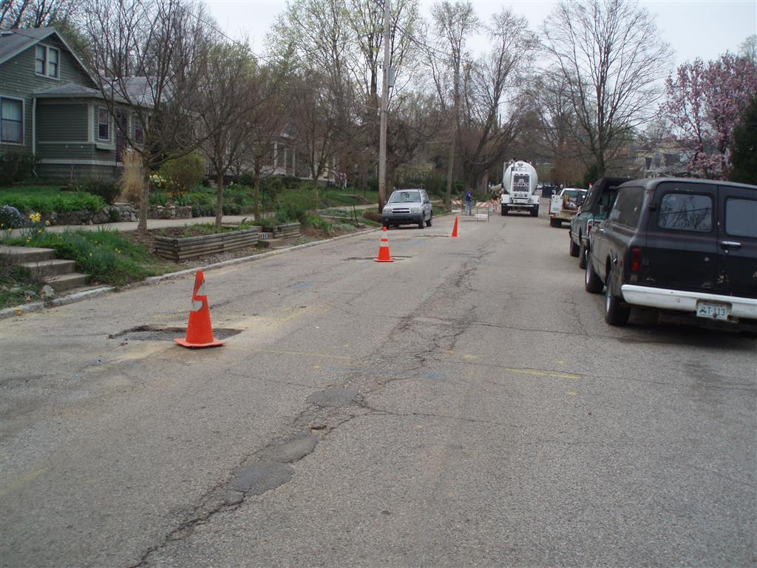
Neofit Case Studies-Louisville
In 2008, eight homes had their service pipes lined with Neofit. First flush ranged from 1.6 to 3.8µg/L (micrograms per liter), well below the action limit of 15µg/L. During the demonstration, the homes were supplied by CSLs and continued to be after the demonstration. Nearly eight years later, five of the lined LSLs could be revisited (Ball, 2016, Water Quality Sampling Results
for Neofit® Lined Lead Drinking Water Service Lines). This is considered an extreme and unlikely situation and worst-case scenario.

Slide 19
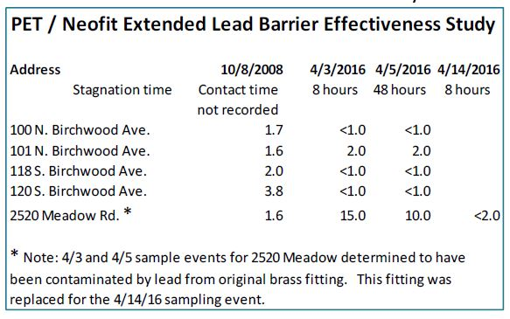
Neofit Case Studies-Louisville
Example of Outliers - Taking note of the 2520 job site, there is clearly an issue here. Seeing as it appears an outlier to the other results, it was investigated further and it was discovered that there were brass fittings used. After replacing the fittings, the lead level significantly dropped to similar levels as the other locations.
Worst Case Scenario
Stagnant & dormant for 8 years
Isolated for 8 years
Importance of Proper Fittings
2520 Issue
Same for replacement
Welter, G. (2016) Pipe coating or lining as alternative strategies for lead service line replacement, 16.

Slide 20
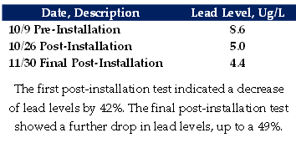
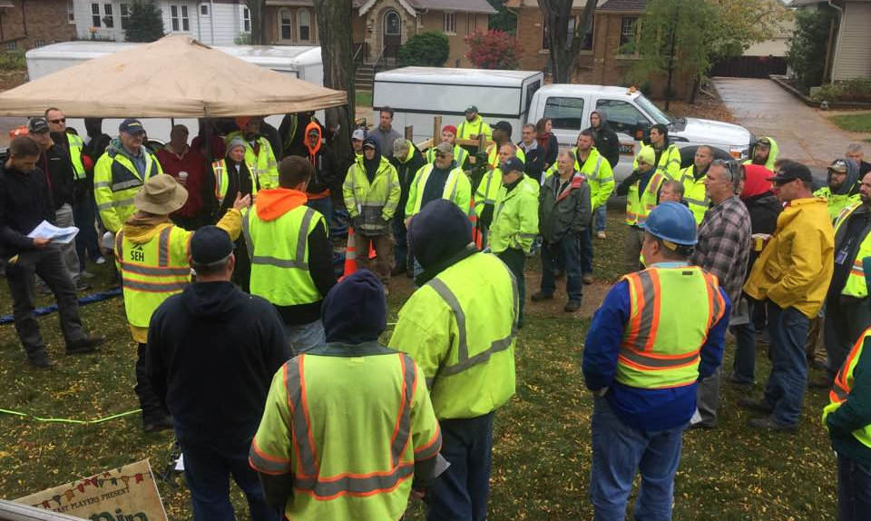
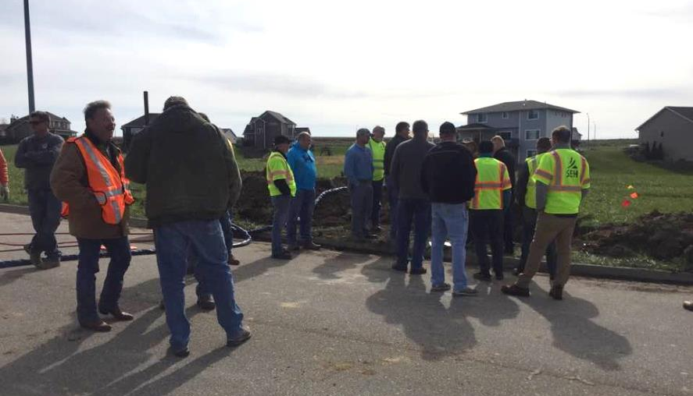
Neofit+ Case Studies – North America
Approval in Wisconsin and Iowa for Live-Installations
In a joint effort with SEH Inc. and LMK Technologies, Neofit+Plus has successfully been installed in a Wauwatosa home with a 1” lead water line, approx. 45ft in length. The home was the winner of lottery drawn to fairly choose who would participate in this live demonstration for the state and WI DNR. Following a preview meeting for the state of Wisconsin in earlier months and receiving state approval shortly after, nearly 80 nearby water authorities observed the live installation. After the successful installation, lead level samples were taken.

Slide 21
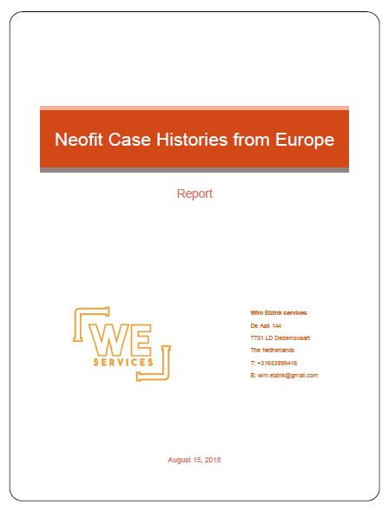
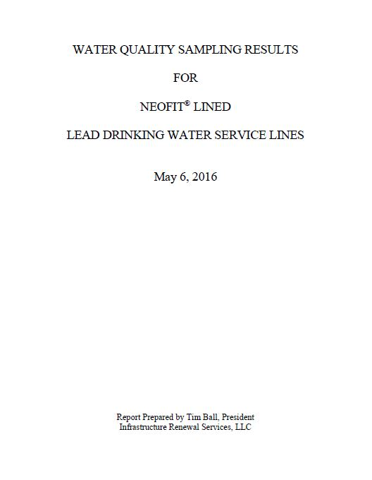
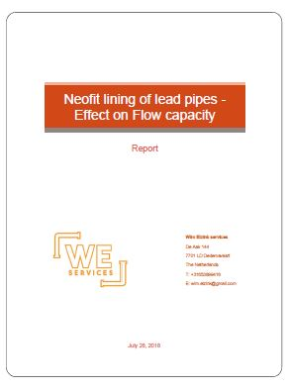
Neofit References
For information on Case Histories of Neofit+.
For information on Louisville Neofit+ Pilot.
For information on flow capacity effects of Neofit+.

Slide 22
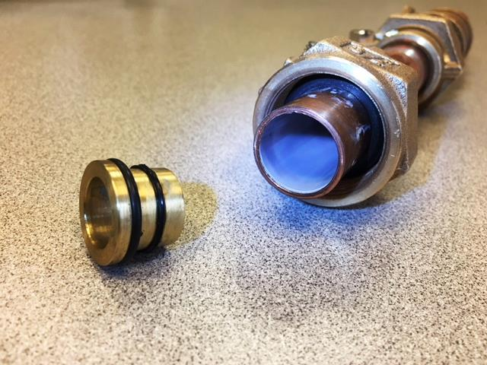
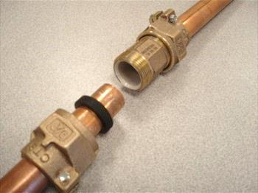
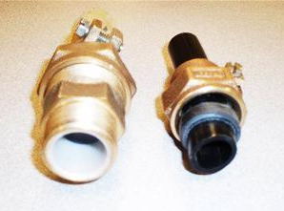
Neofit- Fittings
While Neofit provides a complete barrier, it must also be paired with proper fittings. All connections must be lead free, as 2520 Meadow Rd demonstrates (Louisville). This situation is not a Neofit- only issue, same goes for any other type of rehabilitation. If any scale/sediment were to get into the liner during installation, it would simply be flushed out during the first flush. Any traces of lead afterward would be due to the water being in contact with some other part, not the PET liner.

Slide 23
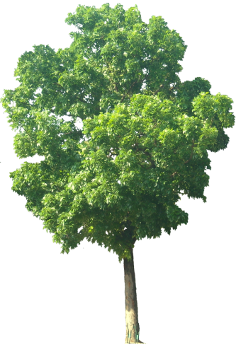
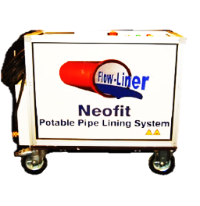
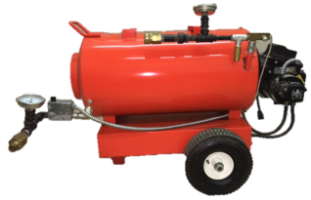
Neofit Basic Installation
The Neofit®+ Plus System Is particularly suitable where alternative solutions prove to be disruptive, such as alongside other infrastructure, under road crossings, in congested ground with other utilities, and in customer properties under drives and gardens. It is also especially beneficial for lining old deteriorating pipes and lines with leaching contaminants, such as lead & copper pipe, as it acts as a barrier.
Neofit® Control Unit
Circulating Hoses
Auxiliary Heating Unit
Municipal Water Supply
House/Building Service Line
Meter in Building
Curb Stop Box/ Access Point
Up to 300ft/91 meters
Installed Neofit® Liner

Slide 24
Neofit Timeline
The Neofit®+ Plus System Timeline (Two person crew- average 50ft install)
Set-up – 30 mins
Cleaning – 30 mins
Lining/Circulating – 30 mins
Reconnect – 20 mins
Clean Up – 10 mins
Total – 2 Hours
Estimated 5-6 Installation/Day with multiple crews tackling different steps (see next slide).
Auxiliary Heating System benefits
Neofit® Control Unit
Circulating Hoses
Auxiliary Heating Unit
House/Building Service Line
Drop Meter in Building
Curb Stop Box/ Access Point
Up to 300ft/91 meters
Inserted then Installed Neofit® Liner

Slide 25
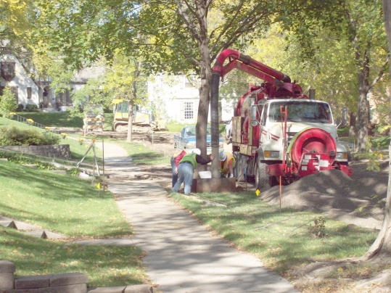
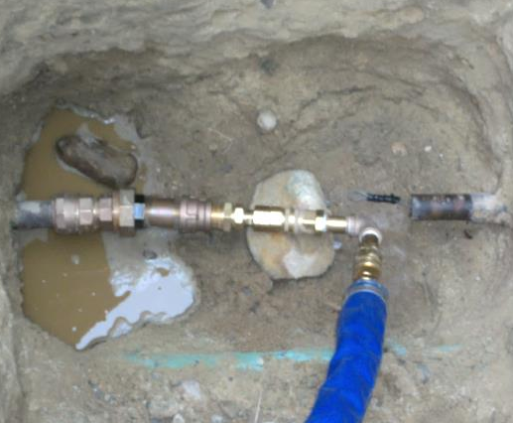
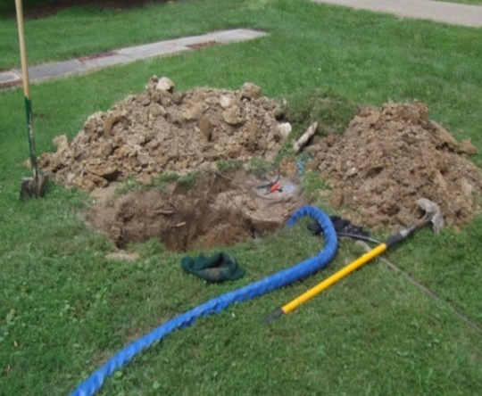
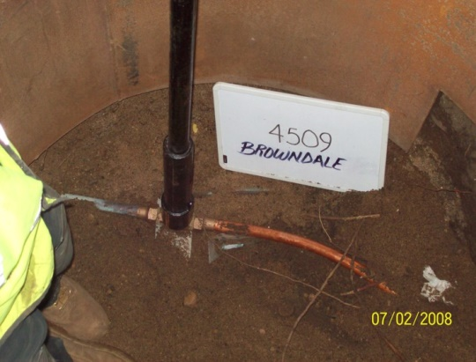
Neofit Ideal Setup
Crew 1
Crew 2
Crew 3
Crew 1- Set-up & Any Necessary Access Pits
Crew 2- Cleaning, Lining, and Expansion Process
Crew 3- Reconnect and Site Clean up

Slide 26
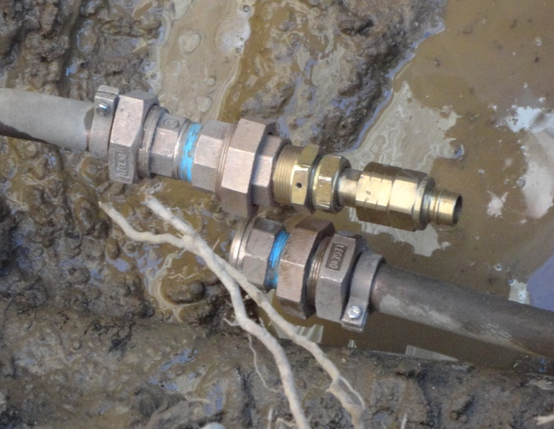
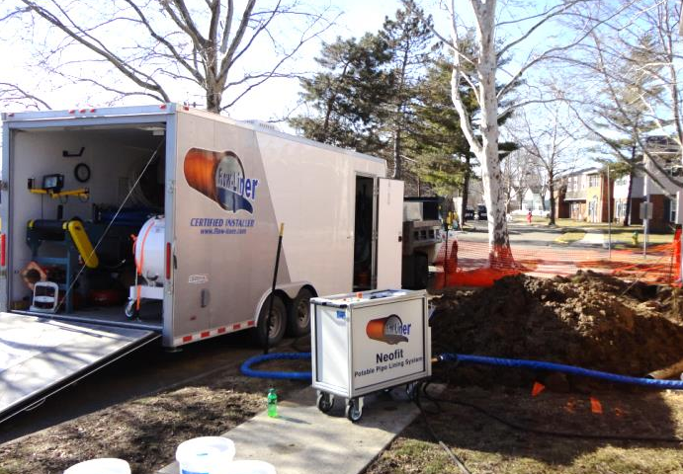
Neofit & Valves
Lining at Valves
Can line through an open valve
Valve cannot be closed once Neofit is installed
Install new valve with Neofit
Install new valve at a different location
At Curb
In Home

Slide 27
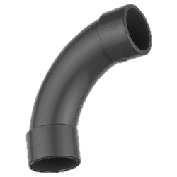
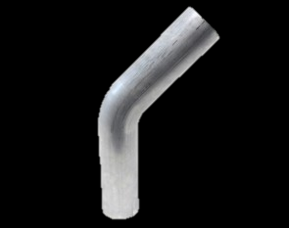
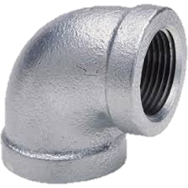
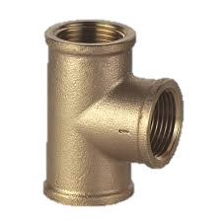
Bends
Acceptable Bends: Long Sweep 90° and =/-45°

Slide 28
Neofit+ & Cleaning
Cleaning Instruments
Mandrels
Brushes
Cleaning Pigs
Jetting
Remove Scale Build-Up
Increase inside diameter
Clear Obstructions and Sharp Obtrusions
Fins found in some lead pipe
Cuts and damages liner
Cleaning does not need to be as intensive as the sandblasting that coatings require. It is best to remove as much scale build-up as possible for the same reasons you would want it removed with or without Neofit liner, increased diameter for increased flow capacity. It is very important to clear the pipe of any sharp obtrusions

Slide 29
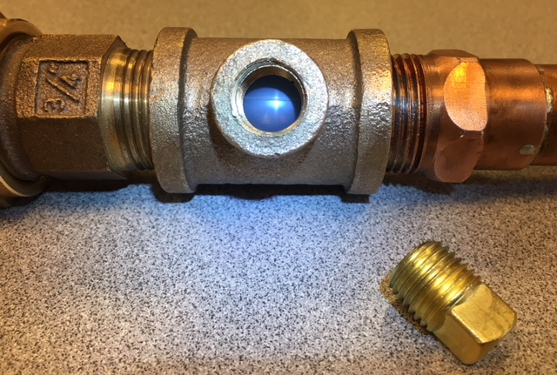
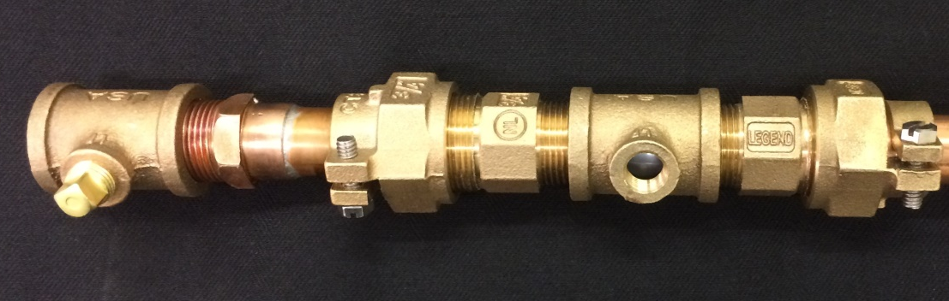
Neofit+ Liner Integrity Test Ports
Test Ports (when required)
Test ports have 3 uses
1) Test ports assist with tracer wire which is used when installing Neofit in smooth plastic pipe to help purge excess air during the expansion process and to trace underground water service piping
2) Test ports act as a final confirmation that liner is not leaking
3) In lead or copper lines, an additional test port would be installed upstream from liner installation to be used for water sampling and contaminate testing

Slide 30
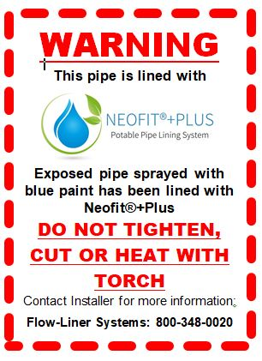
Neofit After Installation
Warning Labels
Tag your lines after installation
Blue Paint Indicators
Immediate Return to Service- NSF
Add Records to Geographic Information System? (e.g. Length of install, date of install, installer name, presence of bends, CCTV inspections?)

Slide 31
Neofit After Installation
One of the many benefits of Neofit, is that if there was an issue during installation, the failure would be instantly known, in which case the liner can be removed immediately.
Repairing Neofit
There could be situations where the liner was damages by and outside source and will need repair. We have 2 repair options for such instances:
1) Neofit+Plus End-Seal™ Repair Fitting (Patent Pending)
An insert fitting to be used in conjunction with AY McDonald and Ford Compression fitting
2) Neofit+Plus Reflaring Kit™ (Patent Pending)
After cutting back the pipe, and exposing the existing liner, a heated expansion tool begins expanding the liner out against a new compression coupling. The pre-heated flaring tool will finish the expansion, beveling the edge of the liner against the fitting.

Slide 32
Neofit After Installation
Frozen lines – Neofit Testing
Figure 1 depicts a ¾” copper pipe lined with Neofit and frozen for 48hrs. Shows no signs of damage to pipe.
Figure 2 depicts ¾” copper pipe not lined with Neofit and frozen for 48hrs. Notice the split in the copper pipe near the fitting.
Figure 3 depicts ¾” PEX tubing with an approx ¼” hole drilled in it and then lined with Neofit. Pipe frozen for 48 hrs. Shows no signs of damage to pipe or any breach where hole is drilled
Conclusion: Pipes lined with Neofit were not damaged when frozen. Neofit added strength to host pipe and protected from splitting as show in figure 2
Frozen Lines – Thawing with Electrical Current
When following the manufacturer's specified instructions, a Neofit lined pipe that has been frozen can be thawed using an electrical current. (Example: Hot-Shot requires 15ft separation of cable clamps)
1
2
3

Slide 33
Neofit Comparison
Pull-In-Place
Access at Both Ends
Will Require Excavation or Demolition
Larger Excavation Pits Necessary
Much More Invasive than Neofit
New Pipe Risks Damage During Process
Open-Cut Excavation
Extremely Invasive
Damaging
Surrounding Utilities
Landscaping, Lawns, Driveway, Sidewalk, Road
Lead Service Line replacement (Flint)
Horizontal Boring
Pull-in-Place Installation
Neofit Installation (Louisville)

Slide 34
Neofit Costs
The EPA reports the average complete LSL replacement to be between $2000-8000, depending on length, depth, and conditions. Could be as high at $18,000. The average savings with Neofit is estimated at 35-45%, increasing in savings as replacement costs increases due to length and especially depth (KIWA, 1995). The cost savings can be expected to be significant, and with including time saving and the convenience of Neofit, replacement hardly measures up.
MLIVE Flint Michigan, 2016
“A pilot study done for the state, to get a handle on the challenge ahead, estimated an average price of $7,500 per house to change water lines.”
Milwaukee Journal Sentinel, 2017
“. . . the city projected costs for each line to be as high as $9,000.”
CBS Chicago, 2016
“Plumbers’ estimates to replace the old lead lines at the Berry home run from $15,000 to $18,000. That is in addition to $3,500 for city permits to perform the work.

Slide 35
Neofit Costs
Average savings estimated at 35-45%
As depth or length of line increases, so does your savings
Time savings
City of Flint, MI estimates:
Best 5hrs (little hard surface excavation, half lead, < 40ft, < 1”, shallow)
Worst 15hrs (hard surface excavation, full lead, > 60ft, >1”, deep)
Average Neofit Installation 2.5hrs regardless of depth

Slide 36
Neofit Dealer to Installer Warranty
Neofit+Plus liner has a standard ten-year limited warranty from the distributor/manufacturer. For municipal projects, Neofit+Plus liner has a 25 year limited warranty.

Slide 37
Neofit+ New Developments
Neofit+ Main Connection System™ (Patent Pending)

Slide 38
Q&A Session
Thank you!

Slide 39
Appendix 1 – The Neofit+Plus System for Installers
Neofit®+ Plus Unit Specifications
For Pipe Sizes: -- 1/2”- 2” ID (U.S.)
For Pipe Types: -- Lead, Plastic, Copper, Galvanized
Operation: -- Automated Controls
Electrical: -- 208V; 60HZ; 3PH
Hot Water Unit: -- Auxiliary Diesel Fired
Weight: -- 310lbs
Dimensions: -- 36” H x 19” W x 40” L
Hoses: -- 25’ Sections w Quick Connect Ends (8)
Lining Capacity: -- Up to 300 lineal feet
Includes: Hoses, Quick Connect Adapters, Hot Water Unit, Air Gun, Coil Dispenser
U.S. Patent No. 8,807,171

Slide 40
Appendix 1 – The Neofit+Plus System for Installers
Neofit®+ Plus Standard Installation Package for ½” – 1” ID pipes
Designed for 7mm and 10mm liner installation and includes:
300 foam cleaning pigs
1 installation adapter
50 O-rings
15 stiffeners
1 set of pulling heads
Neofit®+ Plus Standard Installation Package for 1-¼”– 2” ID pipes
Designed for 15mm and 20mm liner installation and includes:
300 foam cleaning pigs
1 installation adapter
50 O-rings
15 stiffeners
1 set of pulling heads
U.S. Patent No. 8,807,171

Slide 41
Appendix 2 – Lab Testing, Approvals
NSF International ANSI Certification since May 2008
WRAS (Water Regulations Advisory Scheme) European Approved Material
Australian Water Quality Centre
June 2003, Test Report, AS/NZS 4020:2002
Testing of Products for use in Contact with Drinking Water
US Approvals
State of Ohio
City of Columbus, OH
Muskingum County, OH
Washington Suburban Sanitary Commission, MD
Providence Water, RI
State of Wisconsin

