Slide 1
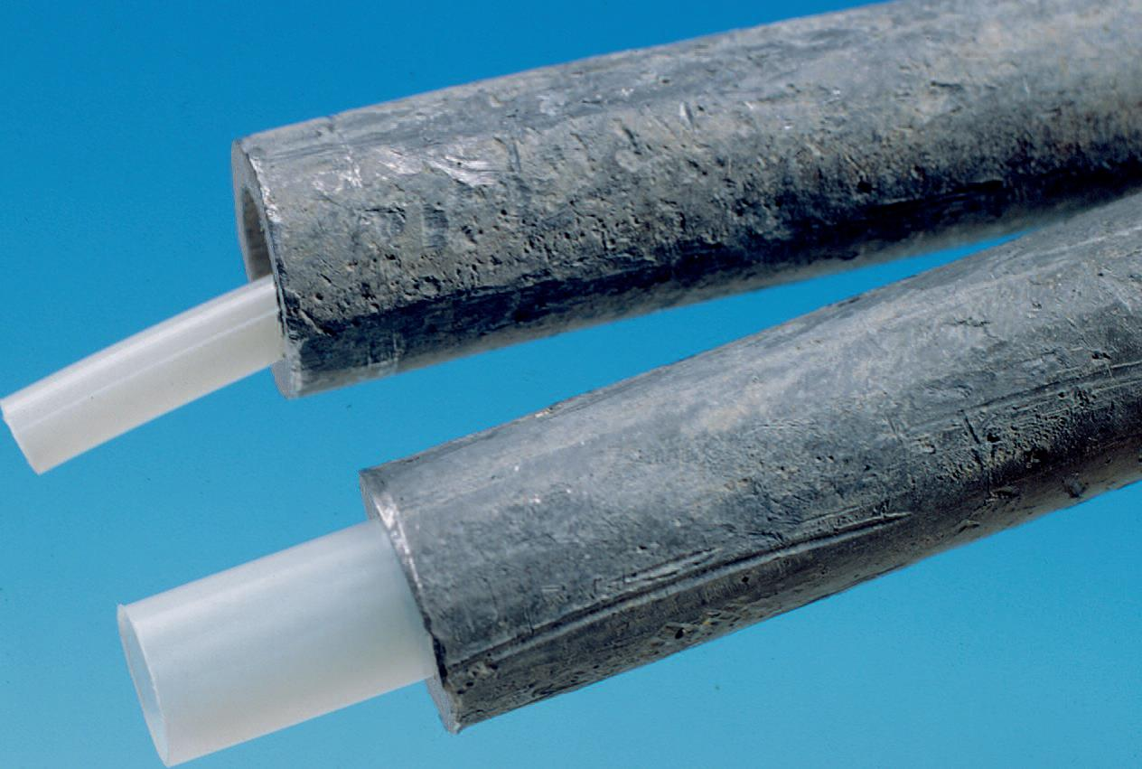
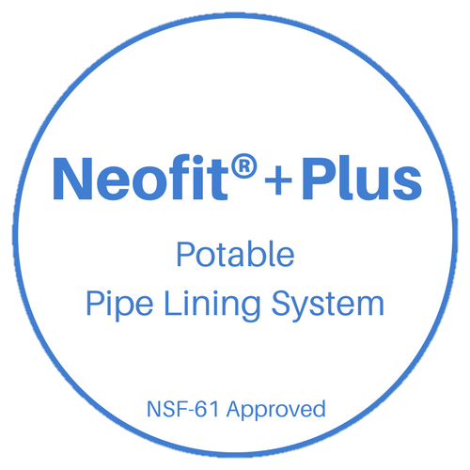
Neofit®+Plus Potable Water Service Lining System

Slide 2
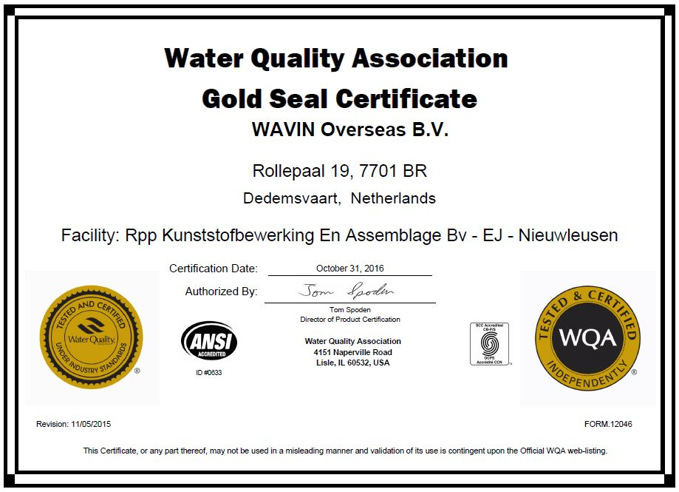
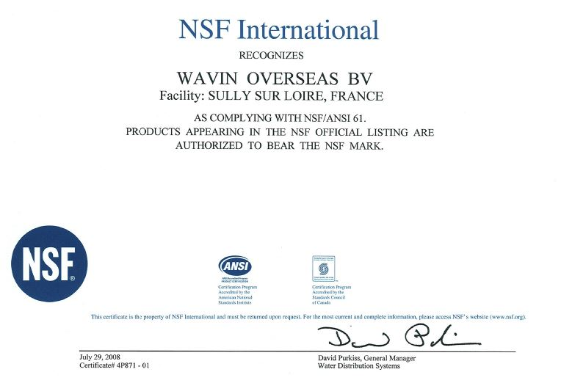
NSF/ANSI 61 Certified
The Water Quality Association has issued certification for Neofit to the standards of NSF 61/ANSI 61 and NSF 61/ANSI 372

Slide 3
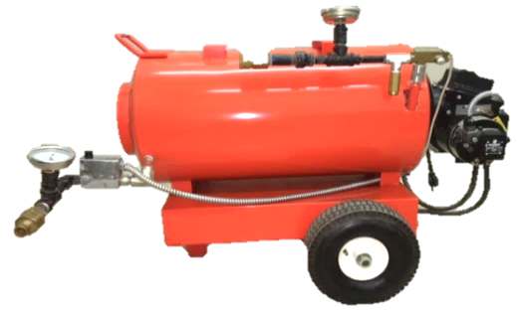
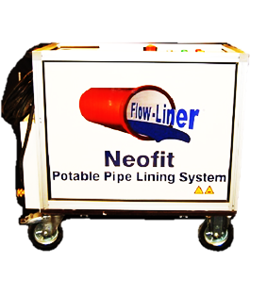
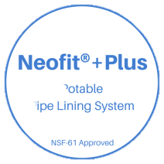
What is Neofit+? – The Basics
Neofit (Virgin PET: Polyethylene Terephthalate) is a cost-effective, trenchless, non-invasive, semi-structural pipe lining system for existing water service lines. Neofit helps maintain the existing service pipe by re-lining, not by replacement. Its purpose is to create a safe barrier in existing lead or copper service piping, extend the existing service pipe’s life, or to seal leaks and pinholes. Designed for ½” to 2” ID and up to 300ft sections.
U.S. Patent No. 8,807,171

Slide 4
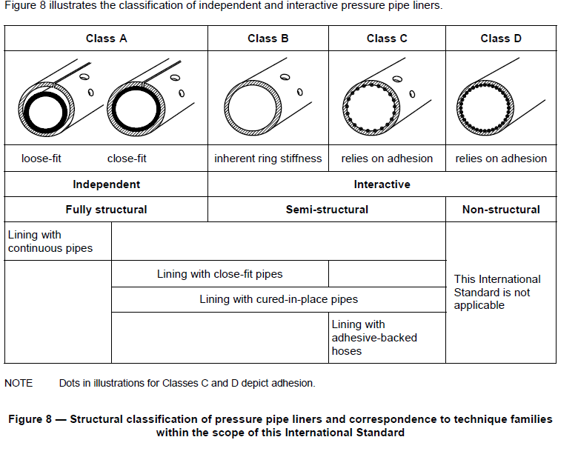
What is Neofit+? – The Liner
Neofit is not a coating technology.
Neofit liner is classified as an interactive semi-structural liner Class B, Close fit that does not need to rely on adhesion.

Slide 5
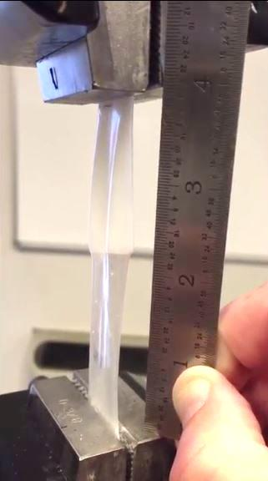
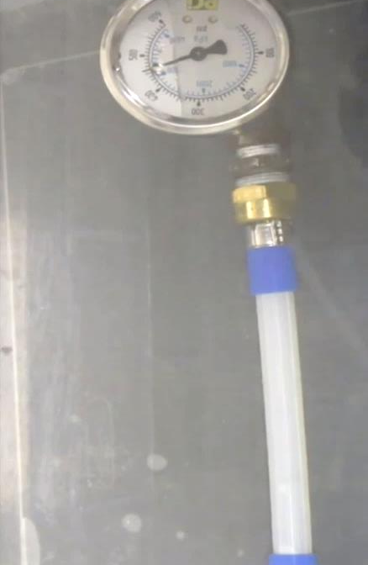
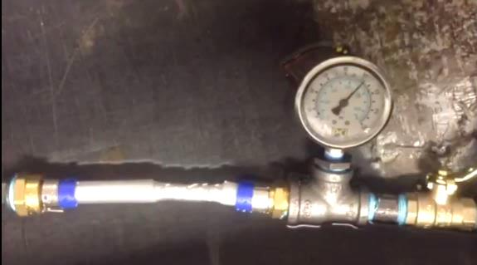
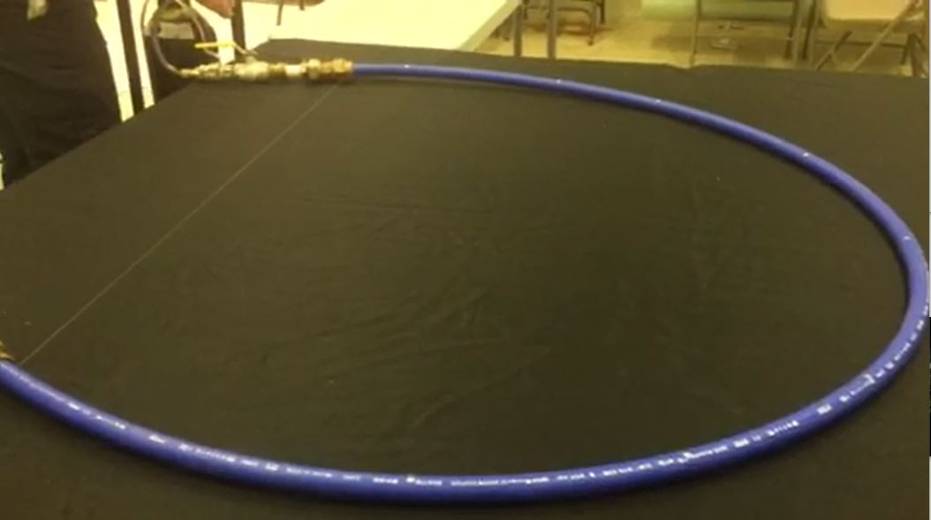
Neofit+ Extreme Testing
3) Expanded Stand Alone Neofit Liner Stretched- Doubles Length
2) 460psi Burst Test, Expanded Stand Alone Neofit Liner
Leak Test
Burst Tests
Tensile Test
Stressed & Stretched
4) 105psi Burst Test, Expanded & Stretched Stand Alone Neofit Liner Under Pressure
1) 150psi Leak Test Neofit Liner

Slide 6
What is Neofit+?
PET
Chemistry - Virgin PET Only- 4X Stronger than the common water bottle and has no recycled material in it and is NSF-61 approved.
Recycled PET has been used for soda and water bottles since the early 1980s with no reports of any short term or long term health issues to humans.
Long-term effectiveness of Neofit
Neofit’s design life is the exact same as new plastic pipe under ISO standards
TOCS, VOCS & NSF 61
TOCS and VOCs are no issue for virgin PET, and the NSF certifications proves it
Chlorine-WRF/EPA Study 2016 (see next slide)
Residual Free Chlorine & Free Chlorine Demand – Decreased with each exposure.
Unlike coating technologies, there is minimal chlorine demand- Better than replacement!
“The chlorine demand exerted by the PET liners in this study was much lower than that observed in the control pipe sections”
Plastic Leachates
Recycled PET vs Virgin PET -- No risk with Virgin PET!

Slide 7
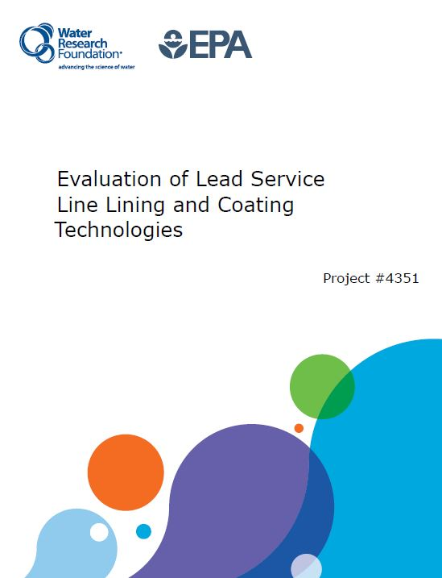
PET Lining
For more technical information regarding the testing and results of Neofit liner, please refer to the Water Research Foundation’s “Evaluation of Lead Service Line Lining and Coating Technologies” pages 121 – 140.

Slide 8
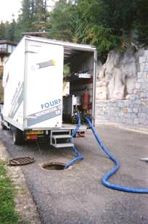
Neofit+ History
France: over 200,000 services
Netherlands, Belgium:
Utilizing Neofit since 1995
Other countries from 2004 on:
Germany, Austria, Australia, Japan Norway, Malaysia, South Africa, Ireland, UK
In total, exceeding 2000 miles of Neofit lined service pipes
Cities of France | # of Services | Installer
Monbéliard | 450 | Generale des Eaux
Dole | 200 | SNCTP
Orléans/Chateaudun | 300 | SAUR
LaTour du Pin | 300 | Fournier TP
Vichy | 200 | CBSE
Cahors | 300 | Capraro & Dubreuilh
Chalons-in-Champagne | 100 | Nord Est TP
Lons-le-Saunier | 100 | Service des Eaux
Pontarlier | 200 | Sté Toubin

Slide 9
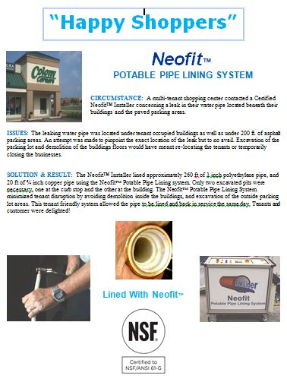
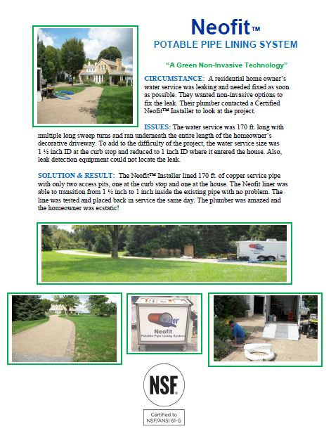
Neofit+ Case Studies – North America
Several Installations since 2008, some listed below:
Louisville Pilot City of Calgary Pilot
Commercial and Residential Examples

Slide 10
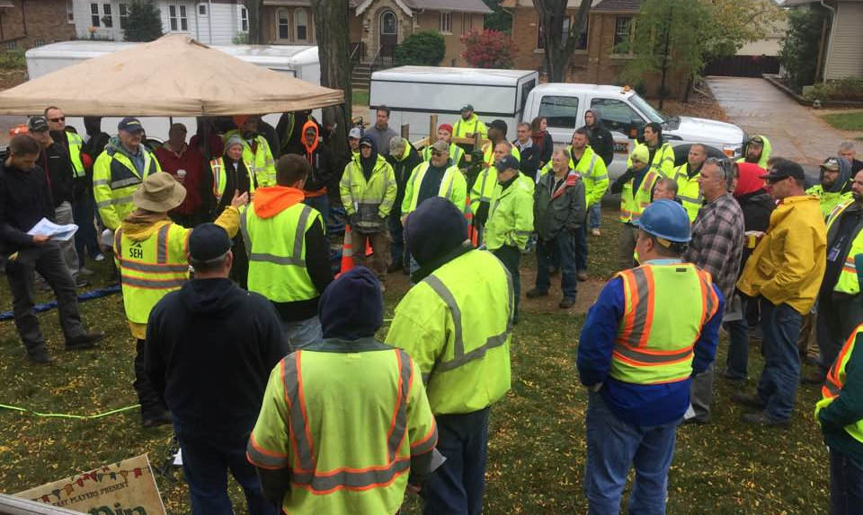
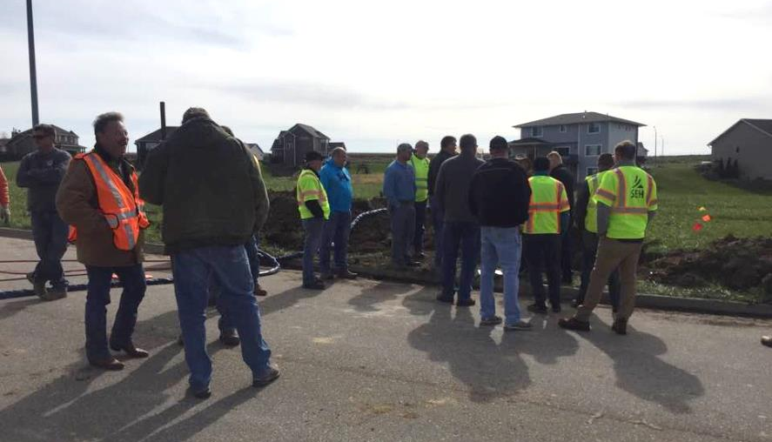
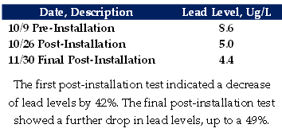
Neofit+ Case Studies – North America
Recent Installations
Approval in Wisconsin and Iowa for Live-Installations
Wauwatosa, WI 1” Lead Water Line
Van Meter, Iowa 1” copper water line

Slide 11
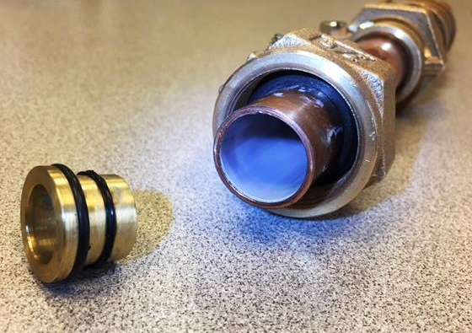
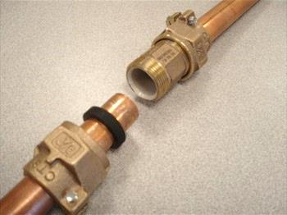
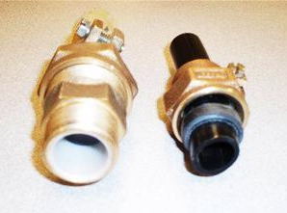
Neofit+ Fittings

Slide 12
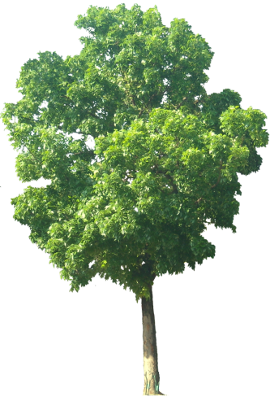
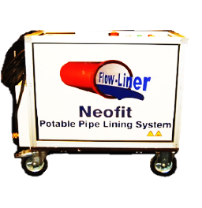
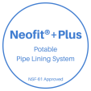
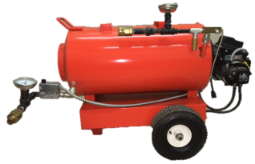
Neofit+ Basic Installation
The Neofit®+ Plus System Is particularly suitable where alternative solutions prove to be disruptive, such as alongside other infrastructure, under road crossings, in congested ground with other utilities, and in customer properties under drives and gardens. It is also especially beneficial for lining old deteriorating pipes and lines with leaching contaminants, such as lead & copper pipe, as it acts as a barrier.
Neofit® Control Unit
Circulating Hoses
Auxiliary Heating Unit
Municipal Water Supply
House/Building Service Line
Meter in Building
Curb Stop Box/ Access Point
Up to 300ft/91 meters
Installed Neofit® Liner

Slide 13
Neofit+ Timeline
Estimated 4-5 Installation/Day with multiple crews tackling different steps (see next slide).
Auxiliary Heating System benefits
More Efficient Installations
Longer Lengths
Larger Diameters
The Neofit®+ Plus System Timeline (Two person crew- average 50ft install)
Set-up – 30 mins
Cleaning – 30 mins
Lining/Circulating – 60 mins
Reconnect – 20 mins
Clean Up – 10 mins
Total – 2.5 Hours
Neofit® Control Unit
Circulating Hoses
Auxiliary Heating Unit
House/Building Service Line
Drop Meter in Building
Curb Stop Box/ Access Point
Up to 300ft/91 meters
Inserted then Installed Neofit® Liner

Slide 14
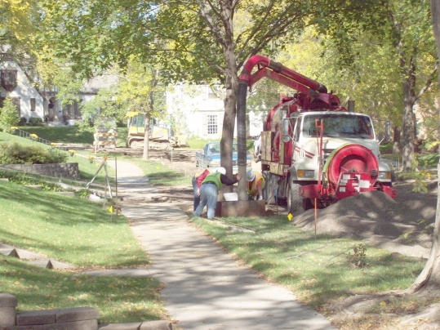
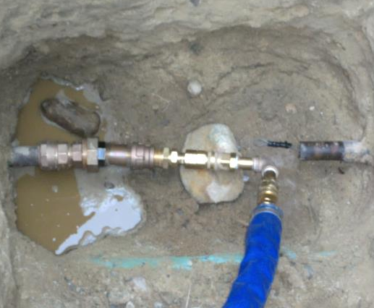
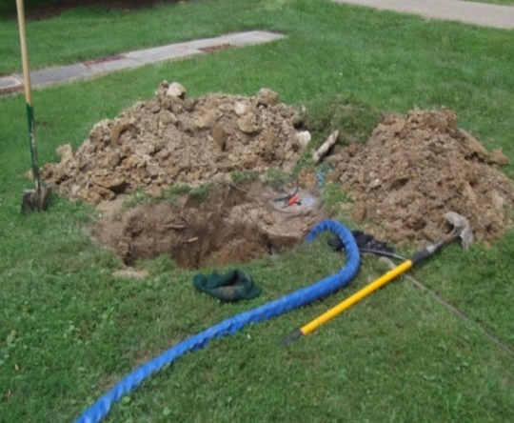
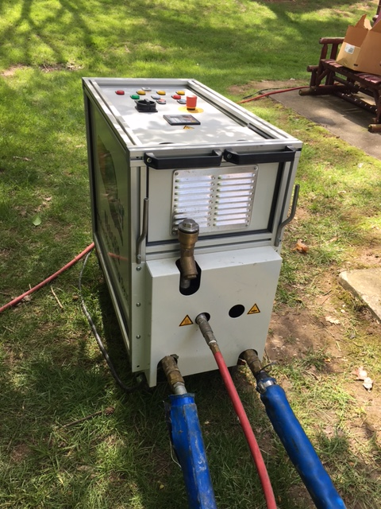
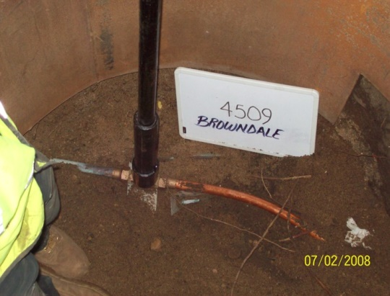
Neofit+ Ideal Setup
Crew 1
Crew 2
Crew 3
Crew 1- Set-up & Any Necessary Access Pits & Prepare for Installation
Crew 2- Cleaning, Lining, and Expansion Process
Crew 3- Reconnection and Site Clean up

Slide 15
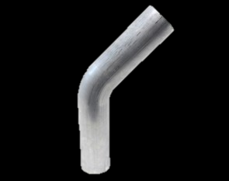
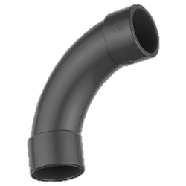
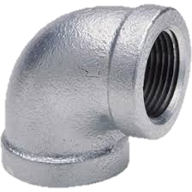
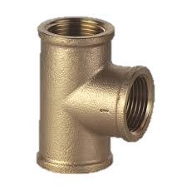
Neofit+ & Bends
Cleaning and Lining of Bends and Curves

Slide 16
Neofit+ & Cleaning
Cleaning
Mandrels
Brushes
Cleaning Pigs
Jetting
Not Coating – Neofit does not take hours to complete
Immediate Return to Service
Remove Scale Build-Up
Increase inside diameter
Clear Obstructions
Clear Sharp Obtrusions
Fins found in some lead pipe

Slide 17
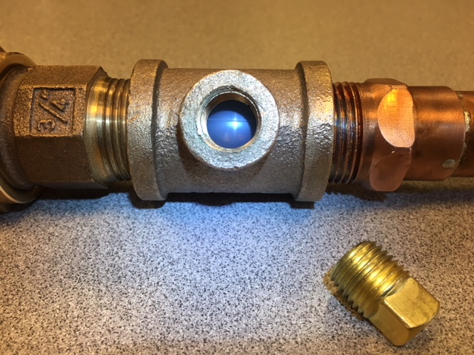
Neofit+ Liner Integrity Test Ports

Slide 18
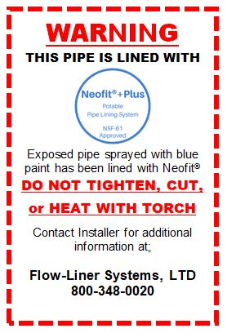
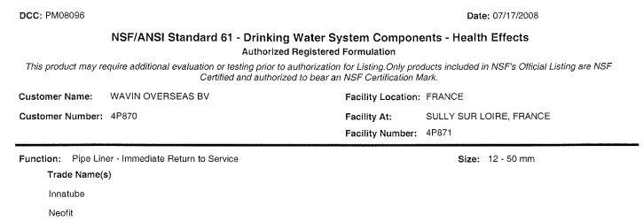
Neofit+ After Installation
Warning Labels
Tag your lines after installation
Blue Paint Indicators
Immediate Return to Service- NSF
Installer Information & Phone Number
Warning Label Example

Slide 19
Neofit+ After Installation
Frozen lines – Neofit Testing
Figure 1 depicts a ¾” copper pipe lined with Neofit and frozen for 48hrs. Shows no signs of damage to pipe.
Figure 2 depicts ¾” copper pipe not lined with Neofit and frozen for 48hrs. Notice the split in the copper pipe near the fitting.
Figure 3 depicts ¾” PEX tubing with an approx ¼” hole drilled in it and then lined with Neofit. Pipe frozen for 48 hrs. Shows no signs of damage to pipe or any breach where hole is drilled
Conclusion: Pipes lined with Neofit were not damaged when frozen. Neofit added strength to host pipe and protected from splitting as show in figure 2
Damaged Line after installation? Two options:
Repairing damaged liner
Removing damaged liner
1
2
3

Slide 20
Neofit+ Cost Savings
Average savings estimated at 35-45%
As depth or length of line increases, so does your savings

Slide 21
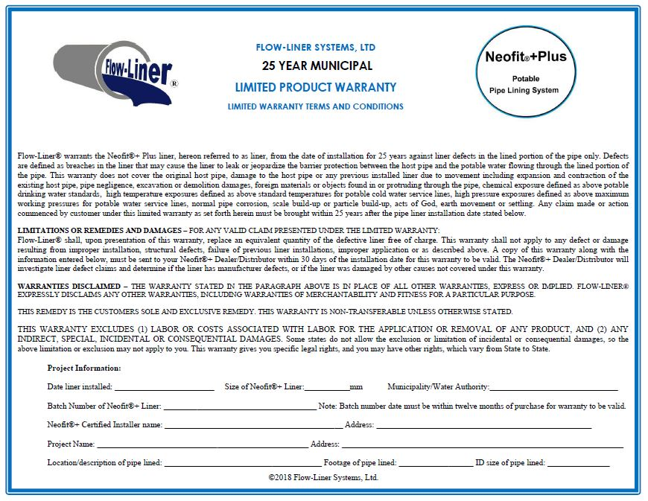
Neofit+ Dealer to Installer Warranty
Neofit+Plus liner has a standard ten-year limited warranty from the distributor/manufacturer. For municipal projects, Neofit+Plus liner has a 25 year limited warranty.

Slide 22
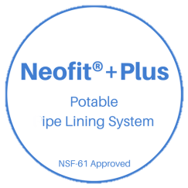
The Neofit+Plus System for Installers
Neofit®+ Plus Unit Specifications
For Pipe Sizes: -- 1/2”- 2” ID (U.S.)
For Pipe Types: -- Lead, Plastic, Copper, Galvanized
Operation: -- Automated Controls
Electrical: -- 208V; 60HZ; 3PH
Hot Water Unit: -- Auxiliary Diesel Fired
Weight: -- 310lbs
Dimensions: -- 36” H x 19” W x 40” L
Hoses: -- 25’ Sections w Quick Connect Ends (8)
Lining Capacity: -- Up to 300 lineal feet
Includes: Hoses, Quick Connect Adapters, Hot Water Unit, Air Gun, Coil Dispenser
U.S. Patent No. 8,807,171

Slide 23
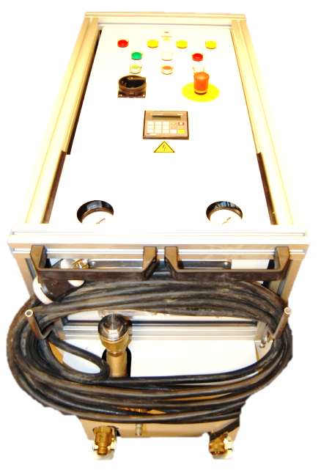
The Neofit+Plus System for Installers
Neofit®+ Plus Standard Installation Package for ½” – 1” ID pipes
Designed for 7mm and 10mm liner installation and includes:
300 foam cleaning pigs
1 installation adapter
50 O-rings
15 stiffeners
1 set of pulling heads
Neofit®+ Plus Standard Installation Package for 1-¼”– 2” ID pipes
Designed for 15mm and 20mm liner installation and includes:
300 foam cleaning pigs
1 installation adapter
50 O-rings
15 stiffeners
1 set of pulling heads
U.S. Patent No. 8,807,171

Slide 24
The Neofit+Plus System Liner Samples
Examples of unexpanded Neofit liner
7mm, 10mm, 15mm, 20mm
For ½-2” ID pipes

Slide 25
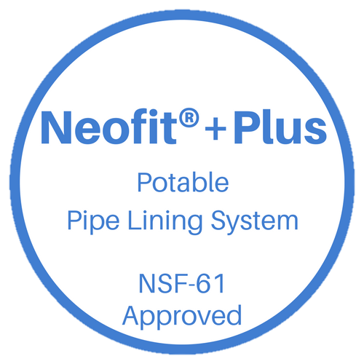
Thank you!

